Slide 1
Cyber Security

Slide 2
AGENDA
Introduction to Software Security
Security vs. Privacy Implications in Software Design
Common Threats and Mitigations
Identity and Access Management
Security as Software Requirement
Threat Modelling
Vulnerability Assessment vs. Penetration Testing
Code Review & Penetration Testing
Aspects of Good Code Review
OWASP ASVP
Privacy by Design and by Default

Slide 3
Introduction to Software Security

Slide 4

Let’s try this Word Search Puzzle
4

Slide 5
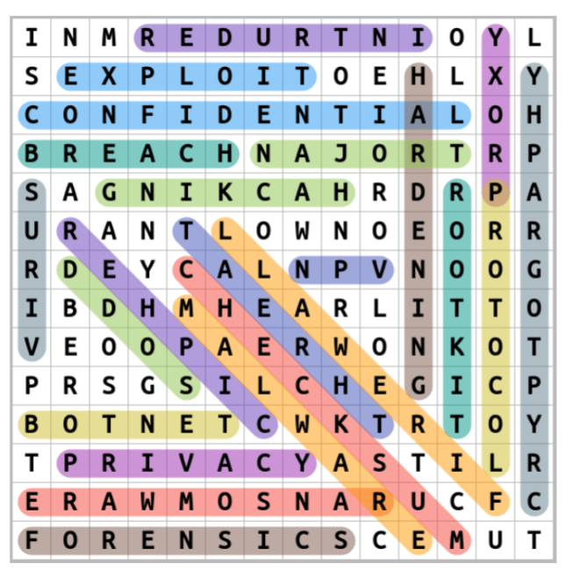
Solution

Slide 6

Information Security vs. Cyber Security
Information Security
Cyber
Security
Cyber Security
Information Security

Slide 7
It’s all about the CIA
Before moving ahead, always remember that
“It’s always about CIA!”
Confidentiality
CIA
Triad
Integrity
Availability

Slide 8
Information Security Standards / Frameworks
ISO 27001, ISO 27002, ISO 27003, ISO 27004, ISO 27005 …
NIST Cyber Security Framework
PCI DSS
HIPAA
GDPR
HITRUST CSF
IT Act
CIS
and many more …

Slide 9
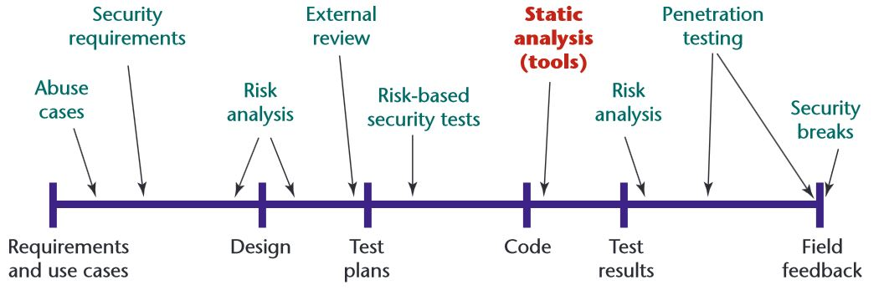
Effective Software Security

Slide 10
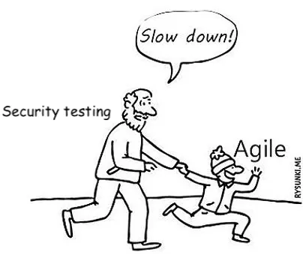
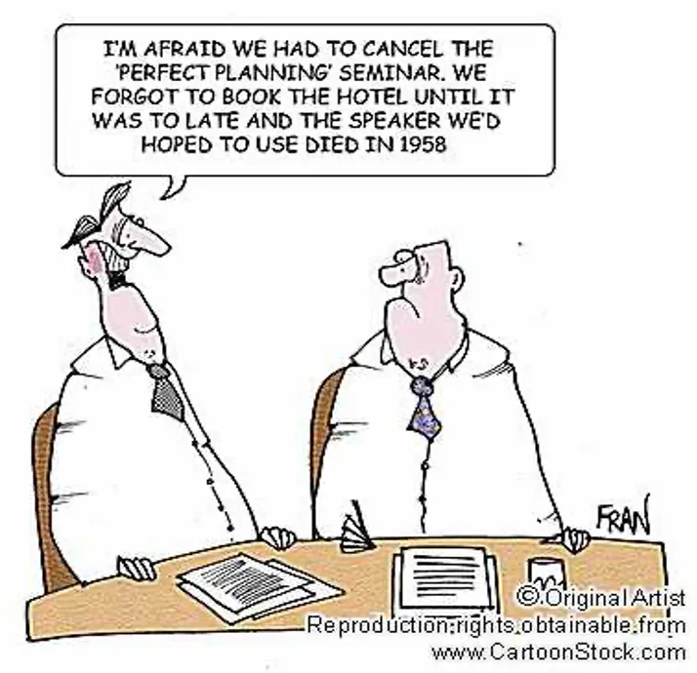
Challenges in Achieving Effective Software Security
Speed of Software Development
Risks of Using Open Source Components
Vulnerabilities in Code
Lack of AppSec Planning
Security Testing during a Secure Software Development Life cycle

Slide 11
Importance of Getting Software Security Right
Software security and security testing are often overlooked aspects of software development
Many businesses don’t realize the importance of it until it’s too late.
1
2
3
Software is now a critical part of most businesses
The majority of the companies heavily rely on some kind of software, and any vulnerability in the code can have serious consequences. Some recent large-scale breaches include the 2021 attack on Facebook, which resulted in exposing the personal information of 1.5 billion users.
The number and severity of attacks are increasing
Hackers are increasingly targeting vulnerabilities as a way to gain access to networks and data. Once the software is compromised, it can take years for a business to recover from damage and losses.
The stakes are higher than ever
The competition within the software industry has seen an explosion in recent years with each business fiercely trying to distinguish themselves with their product or service offering. A vulnerability in software is not only harmful for the users but also for company’s reputation & image.

Slide 12
Security vs. Privacy: Implications in Software Design

Slide 13
What is Data Privacy?
Data privacy refers to the proper use and processing of personal data by restoring control over their data to individuals.
Simply put, data privacy enables individuals to decide and limit access to the use and sharing of their personal data.
Protecting personal information ensures that the data is kept secure.
Here, data privacy transitions into the realm of data security and protection.

Slide 14
Data Privacy Laws
If you’re a business owner with an online presence, you have probably heard about recently enacted numerous data privacy laws in different geographies.
Here are some of the major ones:
EU: General Data Protection Regulation (GDPR)
Canada: Personal Information Protection and Electronic Documents Act (PIPEDA)
CA, USA: The California Online Privacy Protection Act (CalOPPA)
CA, USA: The California Consumer Privacy Act (CCPA)
UT, USA: The Utah Consumer Privacy Act (UCPA)

Slide 15
What is Data Security?
Data security is the concept of protecting digital data from theft, corruption, or unauthorized access throughout its entire lifecycle of:
Creation
Storage
Use
Sharing
Archiving
Destruction
Data security involves physical security of the storage devices and hardware, administrative access controls, and the security of software applications.
It also includes organizational policies and procedure

Slide 16
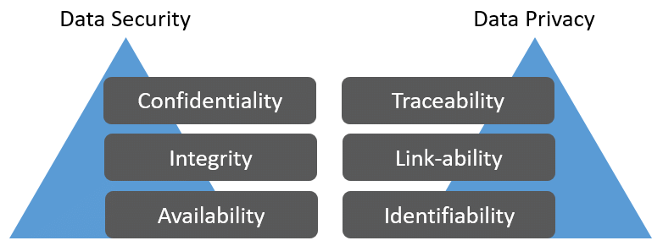
Data Security vs. Data Privacy

Slide 17
Example: Data Privacy
Example.com sells unique products via its eCommerce shop and it collects many pieces of data from its online shoppers such as:
Email addresses and log-in details
Shipping addresses
Billing addresses
To ensure proper handling of personal data and to give individuals control over access to and sharing of their data, Example.com does the following:
It allows its customers to unsubscribe from its email marketing & newsletter lists.
It does not disclose its customers’ email addresses and purchases data to data brokers without getting its customers’ consent.
It stores customers’ purchase information in accordance with data storage periods determined by applicable laws.
These efforts are all part of Example.com’s data privacy strategy.

Slide 18
Example: Data Security
The executives recently decided to update Example.com’s data security policy.
As a result, they hired a data security analyst who brought to their attention that more staff members had access to shoppers’ information than was necessary — weakening the company’s overall data security.
After reviewing which staff members needed access to this information, they reduced the number of “need-to-know” players from 26 to only seven.
Additionally, they allowed an outlet for some other members to request access under special circumstances, for a limited period or a specific task only.
By reducing the number of staff members who could access shoppers’ data by nearly three-quarters, Example.com significantly strengthened its data security plan.

Slide 19
Common Threats and Mitigations

Slide 20
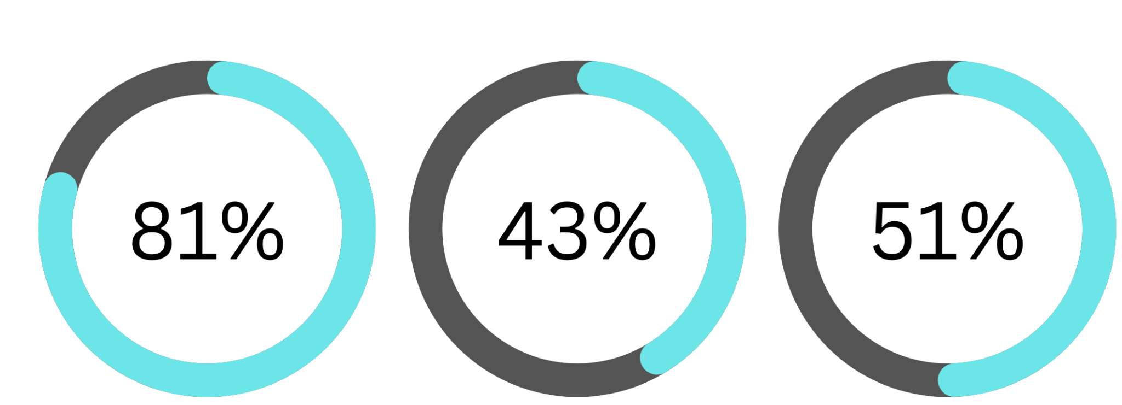
Identity Attacks
Stolen or Weak Password
Social Attacks
Credential Stealing Software
of breaches leveraged either stolen and/or weak passwords
attacks resulted in a data breach
of data breaches include some form of credential stealing software

Slide 21
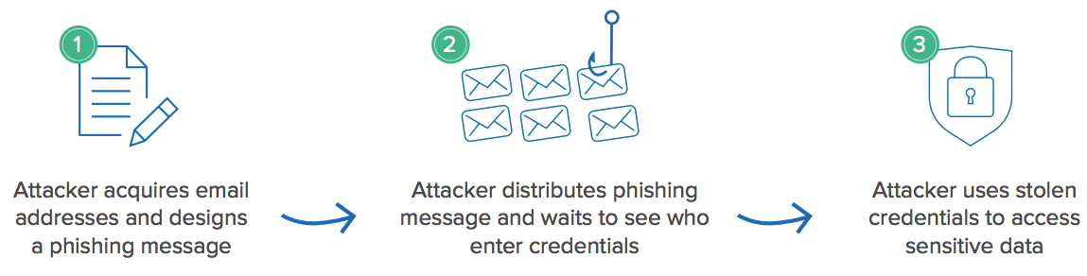
Broad-based Phishing Campaign Attack

Slide 22
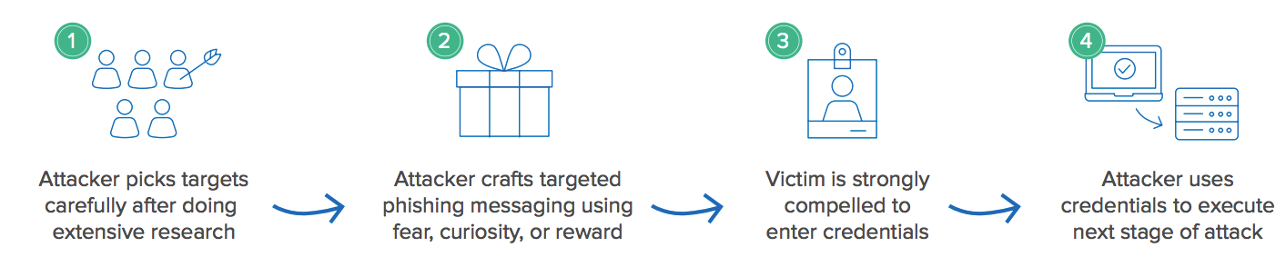
Spear Phishing Campaign Attack

Slide 23
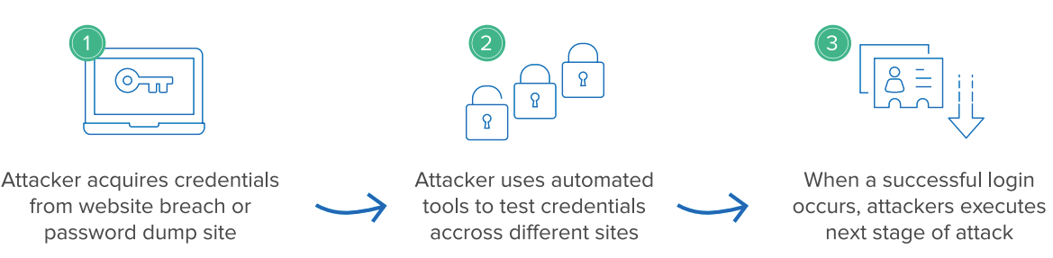
Credential Stuffing Attack

Slide 24
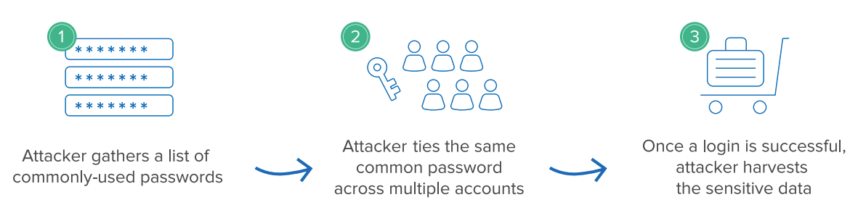
Password spraying attack

Slide 25
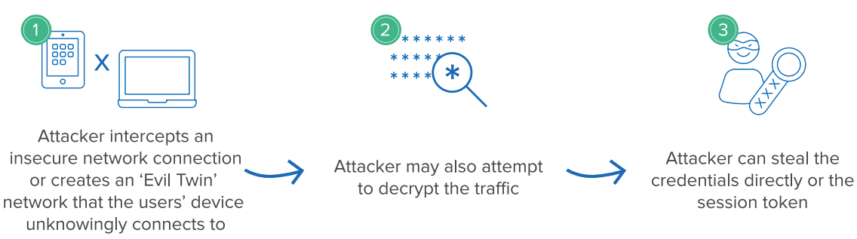
Man-in-the Middle attack

Slide 26
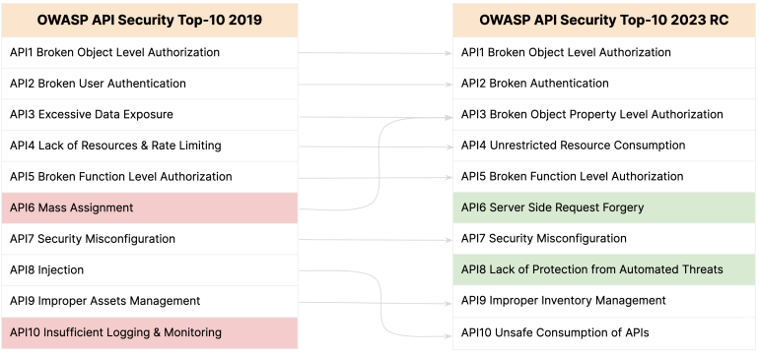
OWASP Top 10
Image Source: https://securityboulevard.com/2023/03/insights-into-the-new-owasp-api-security-top-10-for-cisos/

Slide 27
Identity and Access Management

Slide 28
IAM Overview
Identity and access management (IAM) is a framework of business processes, policies and technologies that facilitates the management of electronic or digital identities.
With an IAM framework in place, information technology (IT) managers can control user access to critical information within their organizations .
Systems used for IAM include single sign-on systems, two-factor authentication, multifactor authentication and privileged access management.
These technologies also provide the ability to securely store identity and profile data as well as data governance functions to ensure that only necessary and relevant data is shared.
IAM systems can be deployed on on-prem systems, through a third-party cloud-based subscription model, or in a hybrid model.

Slide 29
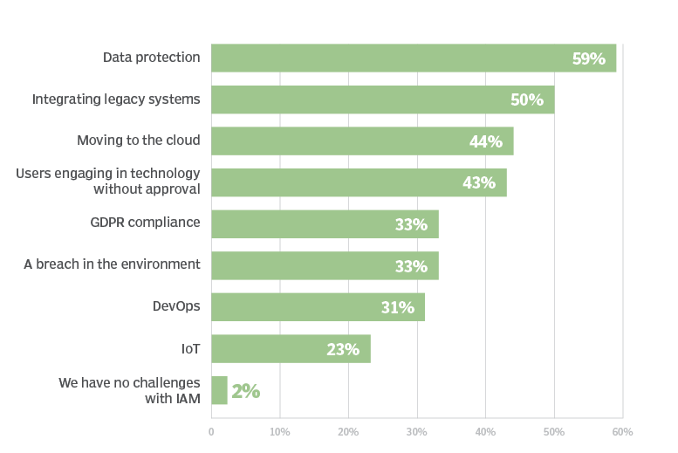
Breakdown of reported IAM Challenges

Slide 30
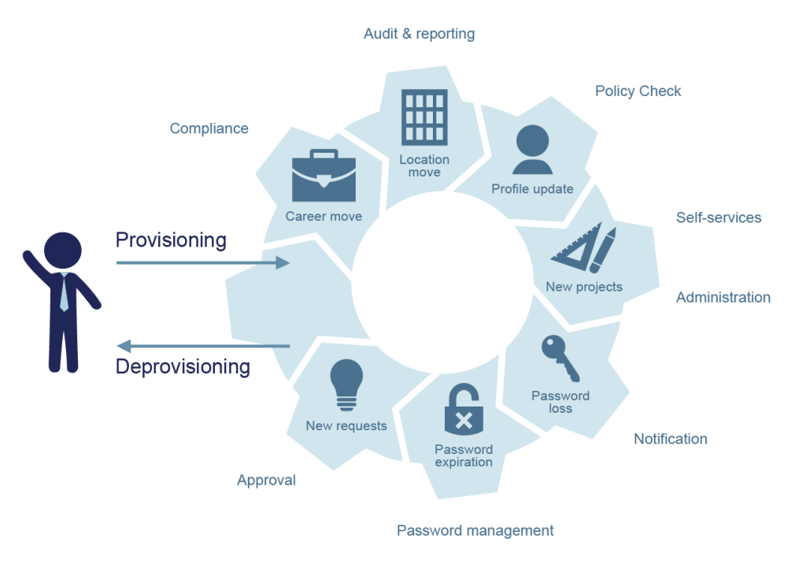
Identity and Access Life Cycle

Slide 31
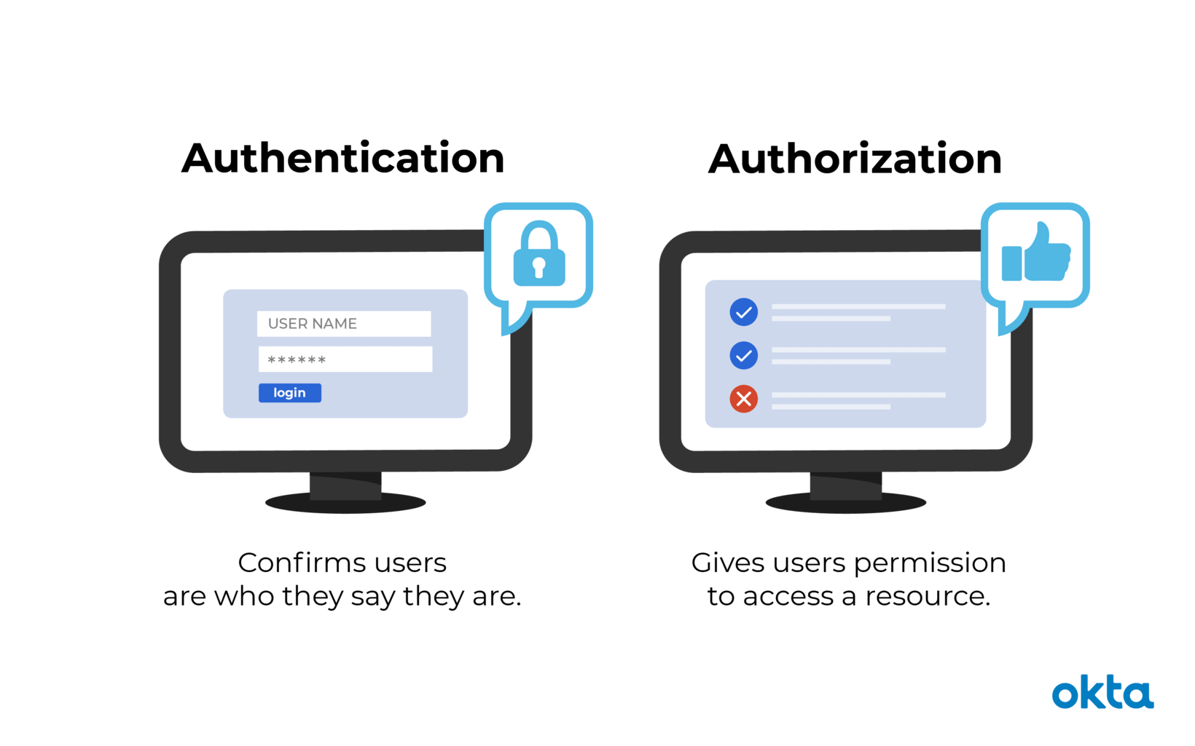
Authentication & Authorization
Authentication
Authorization
Who are you?
Are you allowed to do this?
Validate that system is accessed by the right person
Check if the user has required permissions to access the data

Slide 32
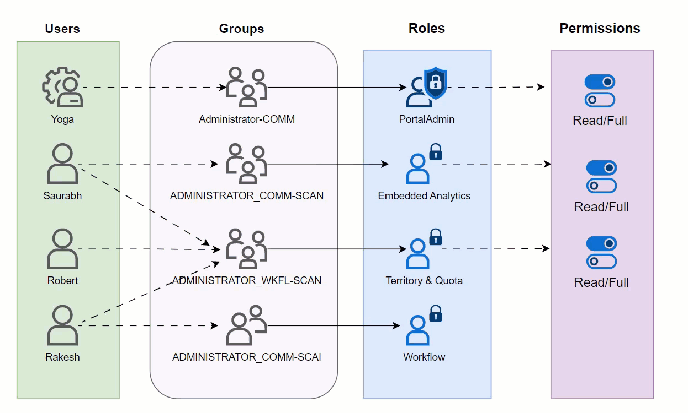
Role Based Access Control (RBAC)

Slide 33
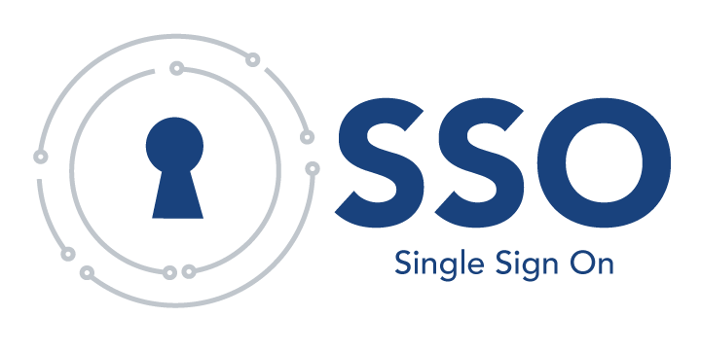
Single Sign-On (SSO)
Single sign-on (SSO) is a one-to-many authentication method that allows users to access multiple resources using a single username/password combination.
Use case: Consider a multi-speciality medical hospital, where medical users (doctors, nursing staff, etc.) may need access to the electronic medical records systems, then toggle over to the laboratory software, pharmacy system, bed management system, and so on. If at each point they need to fill in credentials, then ir can become frustrating.
With SSO, they’ll login only once a day into the system and all applications will share their common session.

Slide 34
Single Sign-On (SSO) Benefits
Single sign-on offers several benefits:
Productivity: SSO allows users to access multiple resources efficiently and securely, reducing potential downtime lost to account lockouts or forgotten credentials.
User experience: Accessing applications on multiple devices with one sign-on improves the working experience of your staff.
Compliance: SSO provides a centralized, secure, and auditable authentication mechanism in compliance with applicable regulatory requirements, including HIPAA and Payment Card Industry Data Security Standard (PCI-DSS).
Security: SSO has been shown to improve adoption of password complexity and multi-factor authentication among employees dealing with critical and sensitive data, resulting in improved security.
Monitoring: With SSO, IT departments an easily monitor user activity and limit data access through robust account administration and auditing features.

Slide 35
Potential pitfalls of Single Sign-On (SSO)
Despite the many positive benefits of SSO, there are some notable pitfalls of SSO, including:
Access: SSO introduces new layers of complexity and potential reliance on 3rd party platforms. This could impact access to applications should a logon portal become inaccessible or malfunction.
Interoperability: Legacy applications that don’t support SSO can pose challenges for IT teams, who may need to create exceptions and workarounds to ensure these applications continue functioning.
Threat detection: Over-reliance on one single authentication mechanism can make it harder for security teams to detect suspicious behaviors as it can be difficult to distinguish between legitimate and unauthorized user activities.
Credential stuffing: SSO can increase exposure to credential stuffing attacks, which is when hackers use compromised sessions or stolen credentials from one application to gain access to another application connected to the same SSO system.
New risks: There are situations when SSO can introduce new risks, such as increasing the impact of compromised accounts.

Slide 36
Multi-Factor Authentication (MFA)
MFA enhances security by requiring users to provide multiple forms of identification to access an application.
With MFA, users typically provide two or more authentication factors, such as a password and a frequently changing one-time verification code.
This approach significantly reduces the risk of unauthorized access to systems, even if a password is compromised.
Security experts separate MFA factors into three main categories:
Something you know
Something you have
Something you are

Slide 37
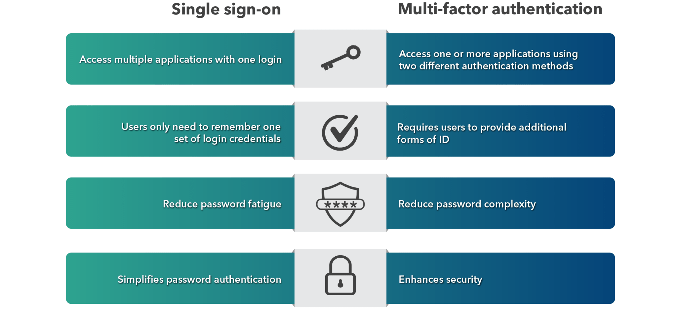
Single Sign-On (SSO) vs. Multi-Factor Authentication

Slide 38
Security as Software Requirement

Slide 39
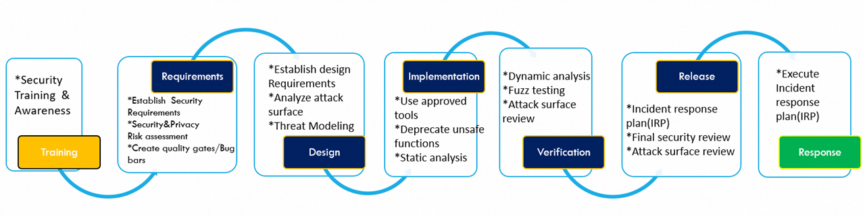
Secure Development Life Cycle

Slide 40
Advantages of Secure Development Life Cycle
Your software is more secure.
All stakeholders are aware of security considerations.
You detect design flaws early, before they’re coded into existence.
You reduce your costs, thanks to early detection and resolution of defects.
You reduce overall intrinsic business risks for your organization.

Slide 41
Vulnerability Assessment vs. Penetration Testing

Slide 42
Vulnerability Assessment
Vulnerability assessment (VA) is the process of defining, detecting, categorizing, and prioritizing security vulnerabilities in a computer system, application, or network.
Organizations rely on vulnerability assessments to provide the crucial intelligence and risk context to understand and respond to cybersecurity threats.
The vulnerability assessment process aims to identify threats and their associated risks. It usually involves using an automated testing tool, such as a network security scanner.
The vulnerability assessment report lists the vulnerabilities in the system under test and possible reasons for the same.

Slide 43
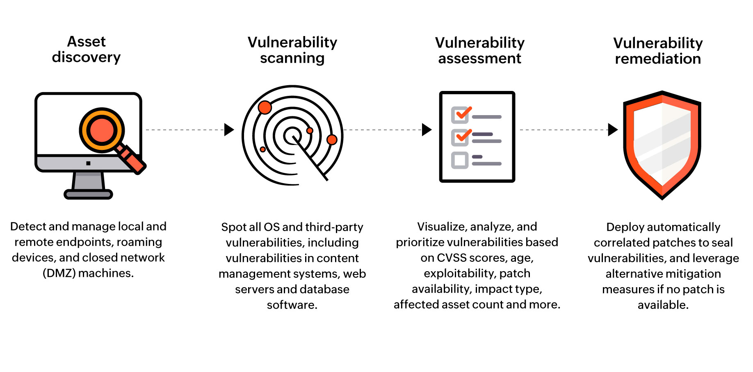
Vulnerability Assessment

Slide 44
Why Vulnerability Assessment?
A vulnerability assessment provides an organization detailed information about security vulnerabilities in their environment.
It also offers guidelines for assessing the risks associated with these vulnerabilities.
This process allows organizations to better understand their assets, security vulnerabilities, and overall risk, making it less likely for attackers to compromise their systems and steal their information.
Vulnerability assessments help identify flaws and threats proactively and as soon as possible allowing orgs to take remedial action to patch the gaps in the organizational infrastructure.
They are also important for ensuring organizations meet cybersecurity compliance requirements, such as the HIPAA and PCI DSS standards.

Slide 45
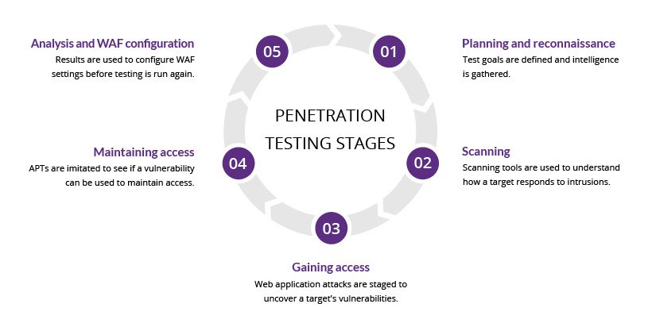
Penetration Testing
WAF: Web Application Firewall
APT: Advanced Persistent Threat

Slide 46
Penetration Testing
Penetration testing is a security method that allows organizations to identify, test, and prioritize vulnerabilities in computer systems and networks
Ethical hackers usually perform penetration tests—these may be internal employees or third-party contractors
Penetration testers imitate the tactics and behaviors of attackers to assess the security posture of an organization’s network, computer system, or web application
Organizations can also use penetration testing to test compliance with industry standards and regulations

Slide 47
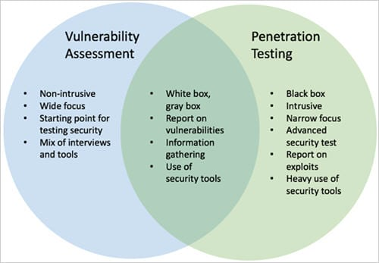
Vulnerability Assessment & Penetration Testing (VAPT)

Slide 48
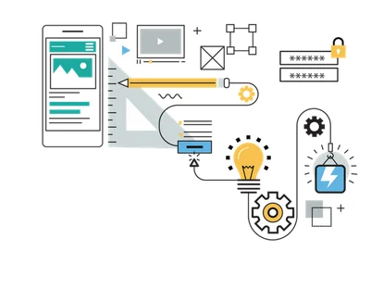
Secure Coding
Secure coding is the practice of developing software that is safeguarded from security vulnerabilities.

Slide 49
Code Review
Code review is an important step in the software development process to get a second opinion on the solution and implementation.
It is a peer review of code that helps developers ensure or improve the code quality before they merge and ship it.
The reviewer can also act as a second step in identifying bugs, logic problems, uncovered edge cases, or other issues.
Reviewers can be from any team or group as long as they’re a domain expert.
If the lines of code cover more than one domain, two experts should review the code.

Slide 50
Questions?

